Slide 1
Google Glass

Slide 2
SHRI SHAMBHUBHAI V. PATEL COLLEGE OF COMPUTER SCIENCE & BUSINESS MANAGEMENT
VEER NARMAD SOUTH GUJARAT UNIVERSITY, SURAT
SEMINAR REPORT
ON
“Google Glass”
PRESENTED BY: GUIDED By:
Mr. Vivek Dhaduk R. Prof. Anahita Pithawala
SPID : 2019021276 Date: 21 / 04 / 2022
Google Glass

Slide 3
Introduction
Have you read about the Google Glass project and wondered what kind of apps you can build or design on Glass?
This seminar is designed to introduce developers and designers (and everyone else) to the Google Glass interface, the Google Mirror API, and the functionalities and limitations of both.
Google is encouraging an ecosystem of developers and designers to build the apps that could make Glass the next iPhone.

Slide 4
Google glass is a wearable computer featuring a head-mounted display in the form of eyeglasses.
It’s a glass with a Smart Phone in it.
It’s brings the internet world and real world together.
It has a micro phone , camera and a screen.
You can take the pictures and shot video with the camera.
It’s also provide the the google map navigations on screen.
What is Google Glass?

Slide 5
History
Google Glass was developed by Google X.
Google started selling a prototype of Google Glass to qualified "Glass Explorers" in the US on April 15, 2013, for a limited period for $1,500, before it became available to the public on May 15, 2014.

Slide 6
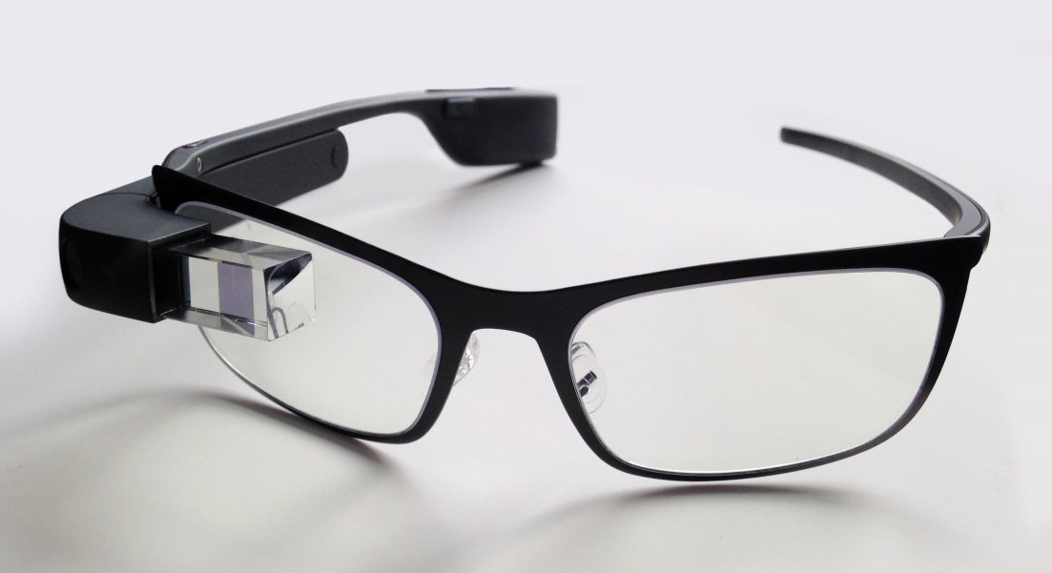
Google Glass

Slide 7
Technologies Used
Wearable Computing
Smart Clothing
Eye Tap Technology
Smart Grid Technology
4G Technology
Android Technology

Slide 8
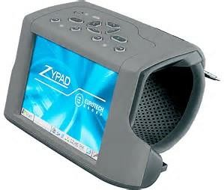
Wearable Computing
Wearable computers, also known as body-borne computers are small electronic devices that are worn by the bearer under, with or on top of clothing.

Slide 9
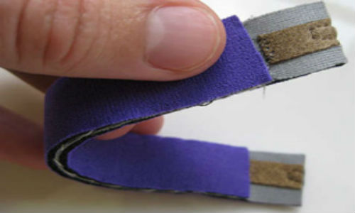
Smart Clothing
It is a combination of new fabric technology and digital technology, which means that the clothing is made with new signal-transfer fabric technology installed with digital devices.

Slide 10
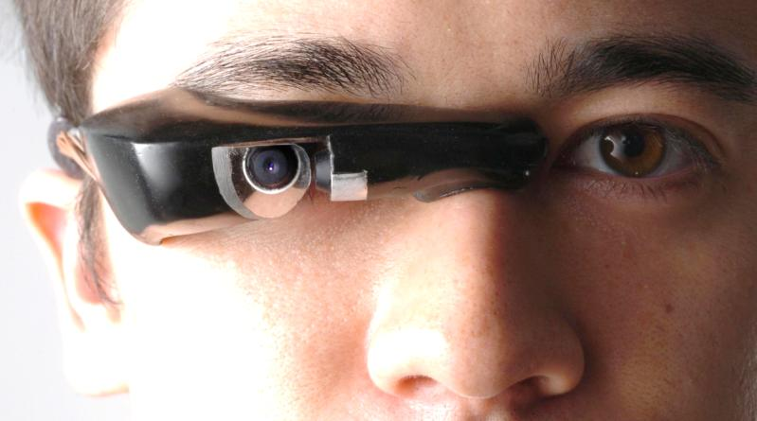
Eye Tap Technology
An Eye Tap is a device that is worn in front of the eye that acts as a camera to record the scene available to the eye as well as a display to a computer-generate imagery on the original scene available to the eye.

Slide 11
Smart Grid Technology
A smart grid is an electrical grid that uses information and communications technology together and act on information, such as information about the behaviors of suppliers and consumers, in an automated fashion
it improve the efficiency, reliability, economics of the production and distribution of electricity.

Slide 12
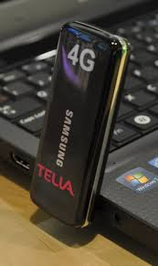
4G Technology
It is a successor of the third generation (3G) standards. A 4G system provides mobile ultra- broadband Internet access, for example to laptops with USB wireless modems, to smart phones, and to other mobile devices.

Slide 13
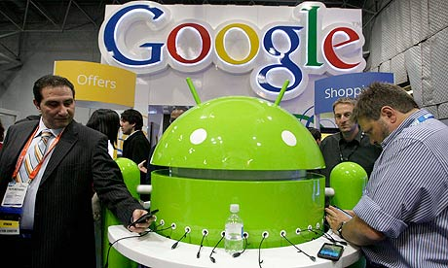
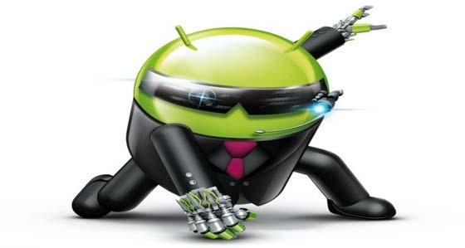
Android Technology
Android is a Linux- based operating system for mobile devices such as smart phones and tablet computers, developed by Google in conjunction with the Open Handset Alliance.

Slide 14
How it Works?
Video Display:
Its features with the small video display that is used to display the pop up hands free information.
Camera:
It also has the front facing video camera with which photos and videos can be taken in a glimpse.
Speaker:
Google glasses are designed to be hands free wearable device that can be used to make or receive calls too.

Slide 15
Button:
A single button on the side of the frame sophisticates the glasses to work with the physical touch input.
Microphone:
A microphone is also put in, that can take the voice commands of the wearer of user. This microphone is also used for having telephonic communication.
How it Works?

Slide 16
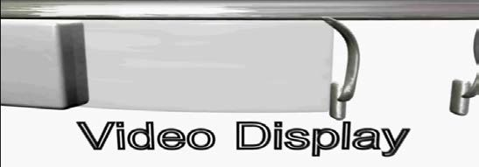
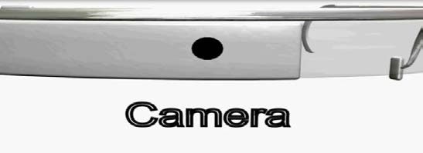
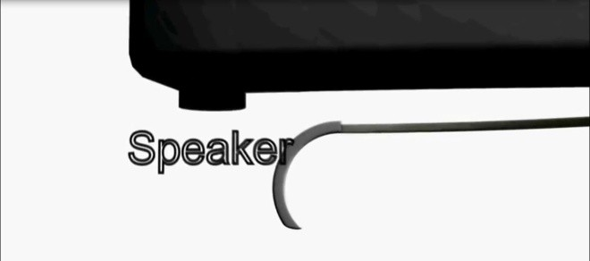
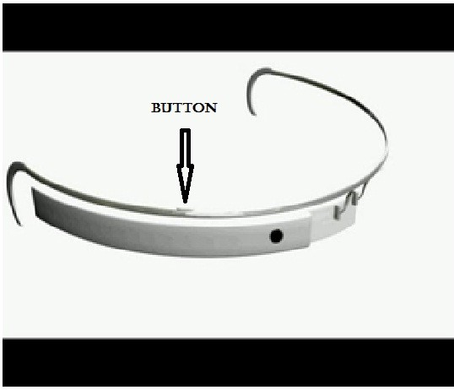
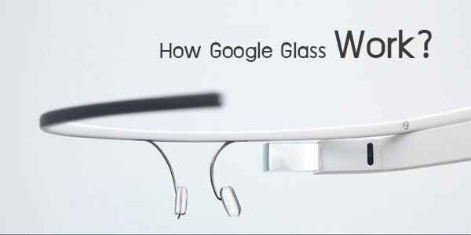
Microphone
Image

Slide 17
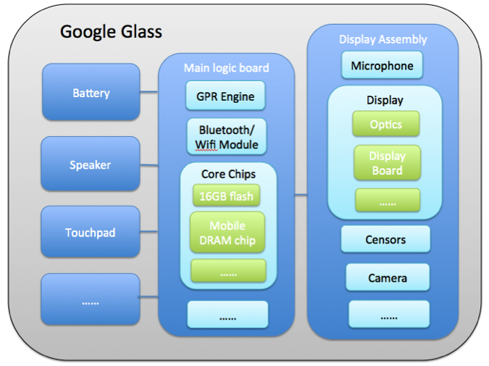
Google Glass Architecture

Slide 18
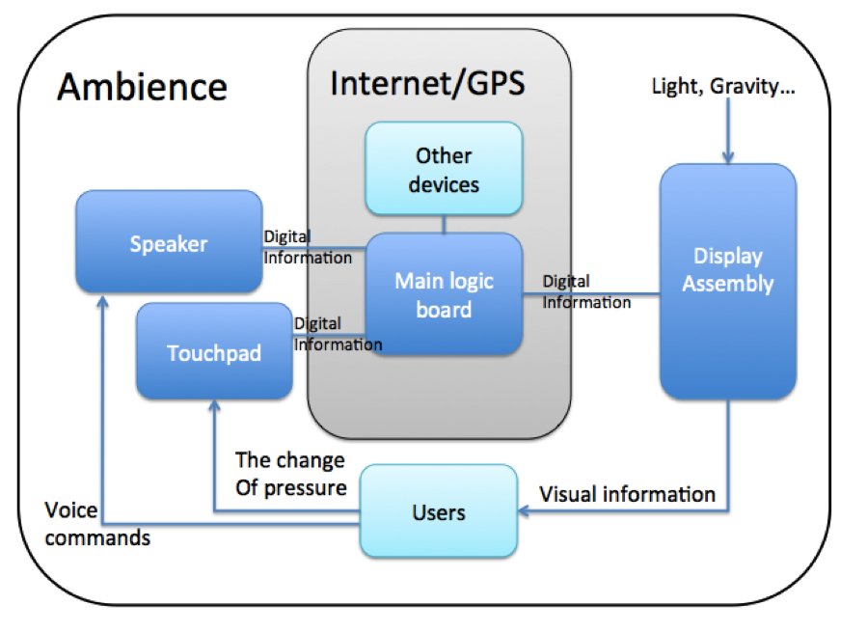

Slide 19

Advantages
Glass is sleek, light and easily wearable and you won’t require keeping it on and off your pockets, like mobile phones.
No Bluetooth or camera needed when Glass is on, it’ll do all for you.
Make phone calls, SMS, emails though Google Glass, no Smartphone required.

Slide 20

Disadvantages
No indication while clicking pictures (like pointing the camera) which almost sounds like a hidden camera trying to capture a non-ready subject.
Chances are there to drop yourself down in the road while reading a text or email since you can’t get your eyes off it.
No public privacy concern so the worry of leaking out information still remains.

Slide 21
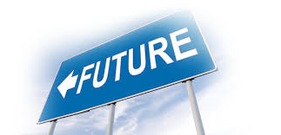
Future Scope
Google Glass is as futuristic a gadget we’ve seen in recent times. It’s limited in scope right now, but the future, Google believes, is bright and the device itself is “incredibly compelling”.

Slide 22
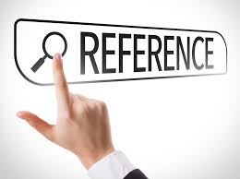
Reference
www.wikipedia.com
www.studymafia.org

Slide 23

Thank you
Thank you

